Slide 1

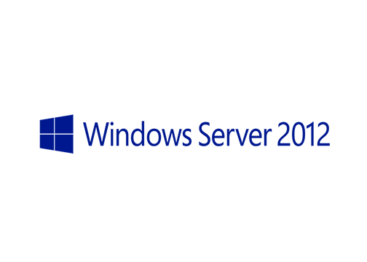
MegaSeries
Storage Spaces

Slide 2
Intro
New feature in Windows Server 2012
This is Microsoft’s implementation of Software Defined Storage
It creates highly available virtual disks in storage pools that contain disks of different types and sizes
Similar in concept to RAID at a high level
Disks can be added with role of Hot-Spare to replace a failed disk when the failure happens

Slide 3
Resiliency levels
Simple disk (no resiliency)
2-way mirror disk
3-way mirror disk
Parity disk

Slide 4
Provisioning types
Thick provision (allocate all space at creation time)
Thin provision (allocate space in time as required)

Slide 5
https://www.youtube.com/channel/UCcZ-jLbPwNr8E_v9-65n8Iw https://github.com/itknowledge4

